Slide 1
Linear Regression
on Data Stream
ChanYi Hong
EunYoung Ha
Subin Kwak
Wonchang Lee
Group 2
PPT

Slide 2
Project Title
Index
Dataset
Data preprocessing
Description
Conclusion

Slide 3
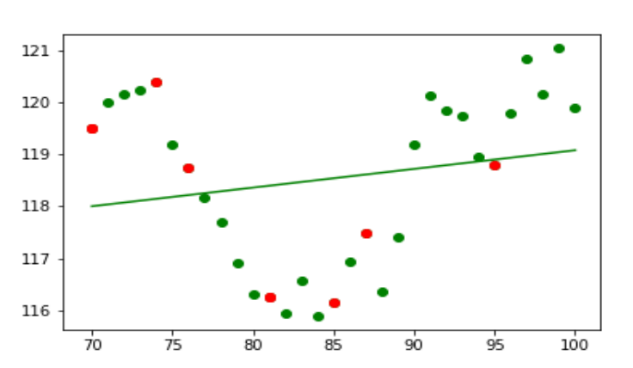
Project Title
Linear Regression
on Data Stream

Slide 4

Description
Collect data about exchange rate between Japan and Australia
Preprocessing data
Transfer data from producer server to consumer server that has window size fixed by 30 by using kafka
Restructuring data to pyspark DataFrame

Slide 5
Description
Split data to training data and test data
Modeling linear regression by using training data and print it
Print error rate by comparing test dataset
When 5 datasets are transferred, refreshing graph in real time.

Slide 6
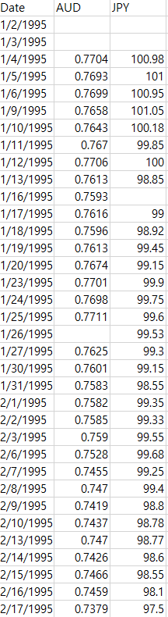
Dataset
- Use Exchange Rate Yen <-> AUD
- Create single producer to send the data
- Create a consumer to show a linear regression model on a plotted data within a certain time frame
- Display both training and testing dataset

Slide 7
Big Data End to End Process
1. Objective Setting
2. Data Curation
3. Data Inspection
4. Data Preprocessing
5. Data Analysis

Slide 8


Objective Setting
Use Exchange Rate Yen <- -> AUD

Slide 9

Data Curation
Kaggle
Currency Exchange Rates
https://www.kaggle.com/thebasss/currency-exchange-rates

Slide 10
Data Inspection
- Total about 6000 rows
- Null value
(AUD : 263, JPY : 316)
- Contains currency information about 20 years
- There are Japanese currency and Australian currency standards, so you can choose between them

Slide 11
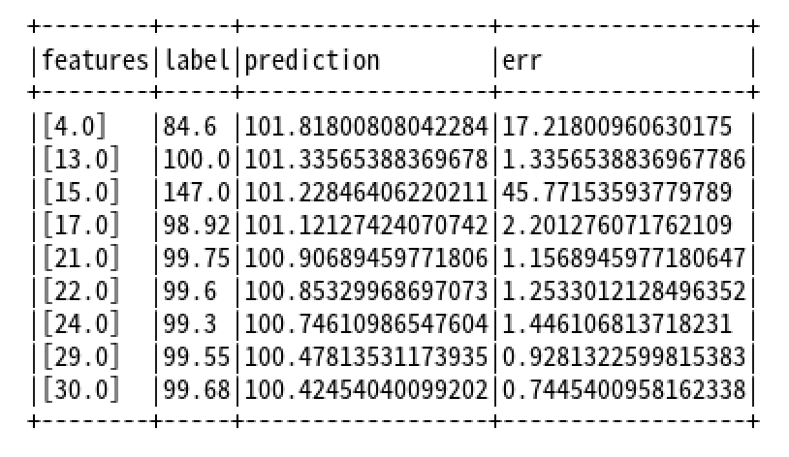
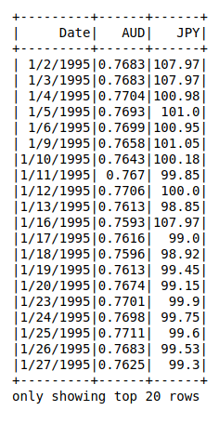
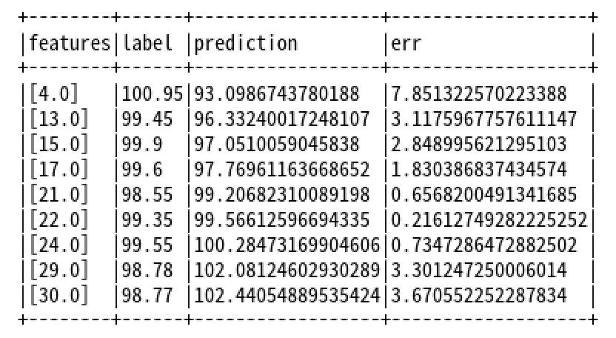
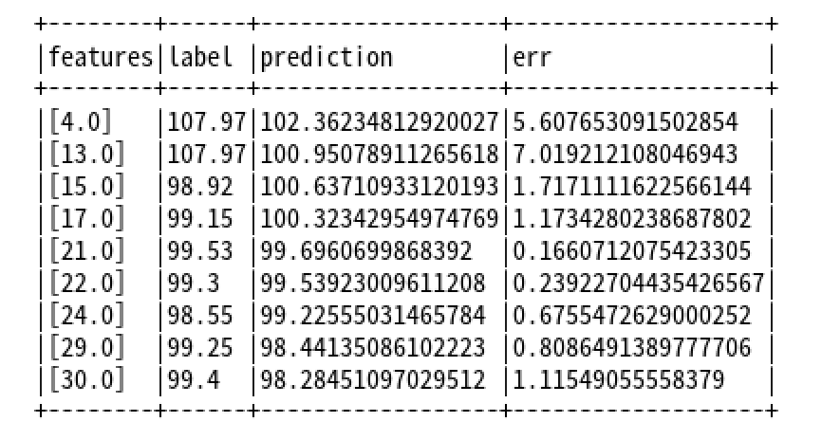
Data Preprocessing
1. Cleaning missing data
2. Fill NA Data to max of column
Fill NA Data to min of column
Fill NA Data to mean of column
3. Drop row that has ‘Date’ NA data

Slide 12
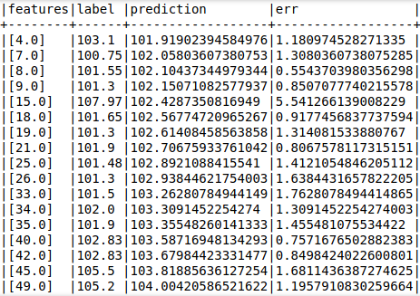
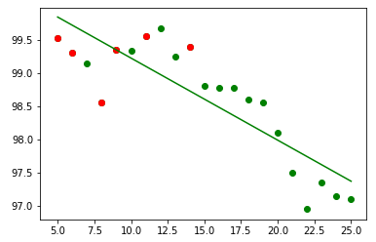
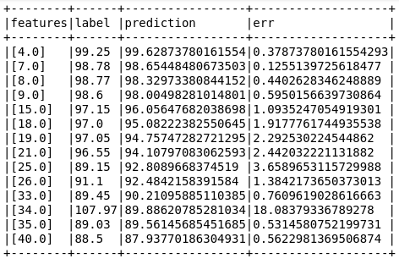
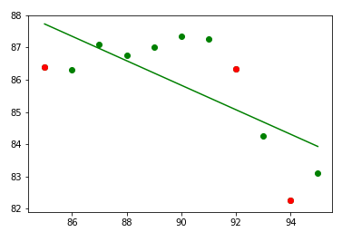
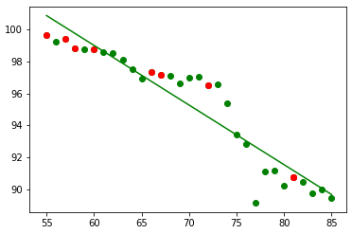
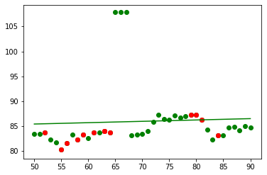
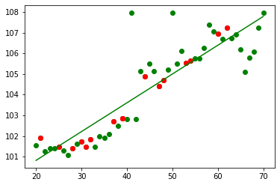
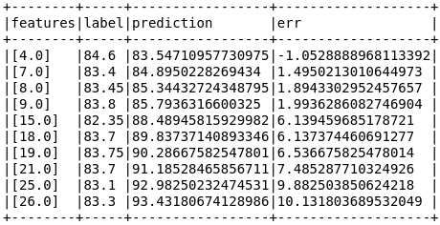
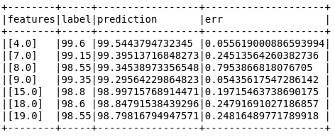
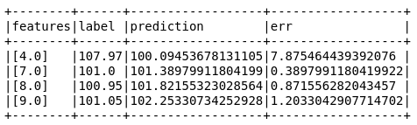
Case 4. Window Size 40
Case 5. Window Size 50
Case 2. Window Size 20
Case 3. Window Size 30
Case 1. Window Size 10
Average of error rate(w10) : 2.58
Average of error rate(w20) : 0.25
Average of error rate(w30) : 5.73
Average of error rate(w40) : 2.28
Average of error rate(w50) : 1.43

Slide 13
Window Size - Error rate
Window size | 10 | 20 | 30 | 40 | 50
Avg(Error Rate) | 2.58 | 0.25 | 5.73 | 2.28 | 1.43
When window size is 20 ➔ Error rate is lowest

Slide 14
Demo

Slide 15
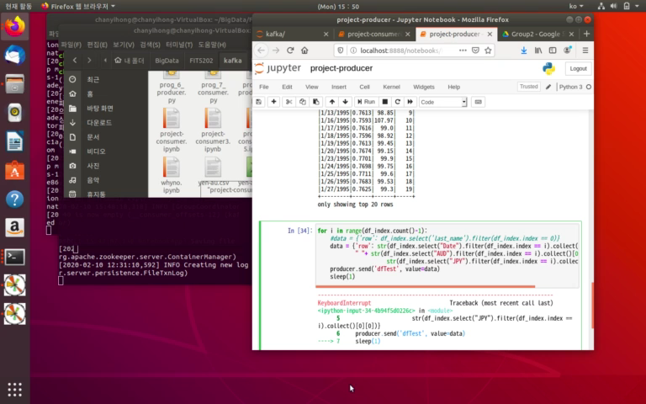

Slide 16
Conclusion
When we learned about machine learning in Korea, we used pandas to preprocess data.
We ran machine learning algorithms using apache sparks and kafka.
I can see that there are many ways to do machine learning.
And streaming data using Kafka was the first thing we learned, which was really interesting.

Slide 17
Thank you

